Slide 1
Strategies to Master the Single Thread
advanced scheduling techniques

Slide 2

Human perception
👏 Users want apps to be snappy
🎞 60fps Device Refresh Rates
- 60 times per second new frame on screen
- 16.66ms Budget ( 1 second / 60 frames )
Notes:
In fact only 10ms because of browsers housekeeping work

Slide 3
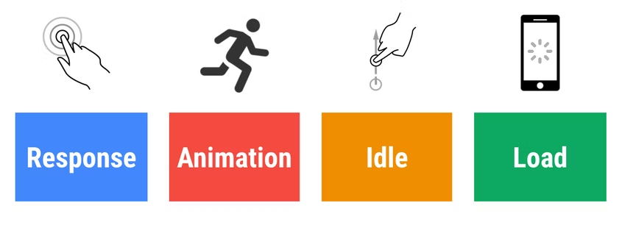
RAIL MODEL
🔗 RAIL model

Slide 4
Focus on the user: Task response times
😍
🙂
< 16 ms
< 100 ms
😐
🥱
🖕
< 1000 ms
> 1000 ms
> 10 000 ms
🔗 RAIL model

Slide 5
Focus on the user: Goals and guidelines
😍
🙂
< 16 ms
< 100 ms
Process tasks in under 50 ms
64.90 ms Task Long task took 64.90 ms
Task
Event: click
work
work2
…
…
…
…
🔗 Long Tasks API

Slide 6
Process tasks in under 50 ms: Keep in mind the others!
Your code
Execute queued macrotask
Task
Event: click
Major GC
work
work2
…
…
…
…
Minor GC
Browser code
rendering
GC
GC
rendering & paint
💡
single-threaded: rendering doesn’t happen while something else is executed

Slide 7
Process tasks in under 50 ms: Approaches to meet the goal
Task
work
...
...
🤏
⛓️
🔀
reduce work
distribute work
Prioritize work
Task
Task
Task
Task
Task
Task
Task
Task
work
work
work
work
workA
workC
workB
workD
...
...
...
...
...
...
...
...
...
preferred solution, but high effort + not always applicable
improve responsiveness by splitting apart the workload into multiple tasks
improve UX by prioritizing the important work to display first

Slide 8
What is the heaviest task in web apps?
🤔

Slide 9
What is the heaviest task in web apps?
💡
evaluating Templates
Rendering
ChangeDetection
aka
aka
64.90 ms Task Long task took 64.90 ms
Task
Event: click
tick
detectChanges
refreshView
...

Slide 10
Distribute Template Work
64.90 ms Task Long task took 64.90 ms
Task
Event: click
tick
detectChanges
refreshView
...
Task
Task
Event: click
Timer fired
tick
detectChanges
detectChanges
refreshView
refreshView
...

Slide 11
Distribute Template Work: with structural directives
app-shell.component.html
<div class="header"></div>
<div class="navigation"
*rxLet=”[]"></div>
<div class="body"></div>
Task
Task
Event: click
Timer fired
tick
detectChanges
detectChanges
refreshView
refreshView
...

Slide 12
Distribute Template Work: with structural directives
app-shell.component.html
let.directive.ts
<div class="header"></div>
<div class="navigation"
*rxLet="[]"></div>
<div class="body"></div>
input$.pipe(
schedule()
).subscribe(() => {
viewRef.detectChanges();
});

Slide 13

Demo Time! Split Template Work

Slide 14

Distribute Template Work: List Rendering
💡
common problem Rendering large lists of items
64.90 ms Task Long task took 64.90 ms
Task
Event: click
tick
detectChanges
refreshView
refreshEmbeddedViews
detectChanges
detectChanges
detectChanges
detectChanges

Slide 15
Distribute Template Work: List Rendering
💡
common problem Rendering large lists of items
64.90 ms Task Long task took 64.90 ms
movie-list.component.html
Task
<movie-card
*ngFor="let.."></movie-card>
Event: click
tick
detectChanges
refreshView
refreshEmbeddedViews
detectChanges
detectChanges
detectChanges
detectChanges

Slide 16
Distribute Template Work: List Rendering
64.90 ms Task Long task took 64.90 ms
Task
Event: click
tick
detectChanges
refreshView
refreshEmbeddedViews
detectChanges
detectChanges
detectChanges
detectChanges
Task
Task
Task
Task
Task
…
Timer fired
Timer fired
Timer fired
Timer fired
…
...
...
...
...
detectChanges
detectChanges
detectChanges
detectChanges

Slide 17
Distribute Template Work: List Rendering - with rxFor
movie-list.component.html
<movie-card
*rxFor="let.."></movie-card>
Task
Task
Task
Task
Task
…
Timer fired
Timer fired
Timer fired
Timer fired
…
...
...
...
...
detectChanges
detectChanges
detectChanges
detectChanges

Slide 18
Demo & Exercise Time!
stackblitz example Split Template Work

Slide 19
How to control the chunks?
🤔

Slide 20

RxAngular Concurrent Mode

Slide 21
Concurrent Strategies: conceptual overview
Scheduling
Chunking
Frame Budget
Priority
Technique to postpone work
Collect work into sized chunks
Force a target framerate 60 fps by default
When to execute?

Slide 22
Concurrent Strategies: scheduling
move work to another task
Task
Task
Event: any
Timer fired
work
work
...
...
...

Slide 23
Concurrent Strategies: chunking
gather and execute work in chunks
Task
Event: any
work
Task
Task
Task
Task
Timer fired
Timer fired
Timer fired
Timer fired
...
...
...
...

Slide 24
Concurrent Strategies: frame budget
control the size of chunks
30 fps > 33.33ms each task
Task
Task
Timer fired
Timer fired
...
...
60 fps > 16.66ms each task
Task
Task
Task
Timer fired
Timer fired
Timer fired
...
...
...
90 fps > 11.11ms each task
Task
Task
Task
Task
Timer fired
Timer fired
Timer fired
Timer fired
...
...
...
...

Slide 25
Concurrent Strategies: frame budget - chunk size computation
60 fps > 16.66ms each task
~ 16 ms
t
Task
work
...

Slide 26
Concurrent Strategies: frame budget - chunk size computation
60 fps > 16.66ms each task
~ 16 ms
t
Task
work
work
...
...

Slide 27
Concurrent Strategies: frame budget - chunk size computation
60 fps > 16.66ms each task
~ 16 ms
t
Task
work
work
work
...
...
...

Slide 28
Concurrent Strategies: frame budget - chunk size computation
60 fps > 16.66ms each task
~ 16 ms
t
Task
work
work
work
work
...
...
...
...

Slide 29
Concurrent Strategies: frame budget - chunk size computation
60 fps > 16.66ms each task
~ 16 ms
t
Task
Task
work
work
work
work
work
...
...
...
...
...

Slide 30
Concurrent Strategies: frame budget - chunk size computation
scheduler.ts
while(task && runtime < threshold) {
task = queue.pop();
runtime += execute(task);
}
💡

Slide 31
Concurrent Strategies: priority
control execution timing
Immediate
userBlocking
Priority: 0
Priority: 1
normal
low
idle
Priority: 2
Priority: 3
Priority: 4
🔗 prioritized post-task

Slide 32
Concurrent Strategies: priority
control execution timing
schedule(work, {priority: 'immediate'});
schedule(work, {priority: 'userBlocking'});
schedule(work, {priority: 'normal'});
schedule(work, {priority: 'low'});
schedule(work, {priority: 'idle'});
immediate
userBlocking
normal
low
idle
Task
Task
Task
Task
Task
Timer fired
Timer fired
Timer fired
Timer fired
Timer fired
...
...
...
...
...
🔗 prioritized post-task

Slide 33
Concurrent Strategies: priority
control render deadline
Immediate
userBlocking
Priority: 0 Deadline: 0 ms
Priority: 1 Deadline: 250 ms
normal
low
idle
Priority: 2 Deadline: 5000 ms
Priority: 3 Deadline: 10000 ms
Priority: 4 Deadline: n/A
🔗 prioritized post-task

Slide 34
Concurrent Strategies: priority - render deadlines
immediately execute task when its deadline is reached
~ 250 ms
t
userBlocking > 250 ms deadline
Task
Task
Task
Task
work
work
work
work
work
work
schedule
...
...
...
...
...
...

Slide 35
Concurrent Strategies: priority - render deadlines
~ 250 ms
~ 5000 ms
t
immediate 0 ms deadline
Task
Task
work
work
work
work
work
work
schedule
...
...
...
...
...
...
userBlocking > 250 ms deadline
Task
Task
Task
Task
work
work
work
work
work
work
schedule
...
...
...
...
...
...
normal > 5000 ms deadline
Task
Task
Task
Task
Task
Task
work
work
work
work
work
work
schedule
...
...
...
...
...
...
idle > no deadline
Task
Task
Task
Task
Task
Task
Task
work
work
work
work
work
work
schedule
...
...
...
...
...
...

Slide 36
But why, though?
🙈

Slide 37

Task Prioritization
prioritize
schedule
...
c
b
a

Slide 38
data
{ }
immediate
low
userBlocking
backup
10101101011100101010
normal
idle

Slide 39
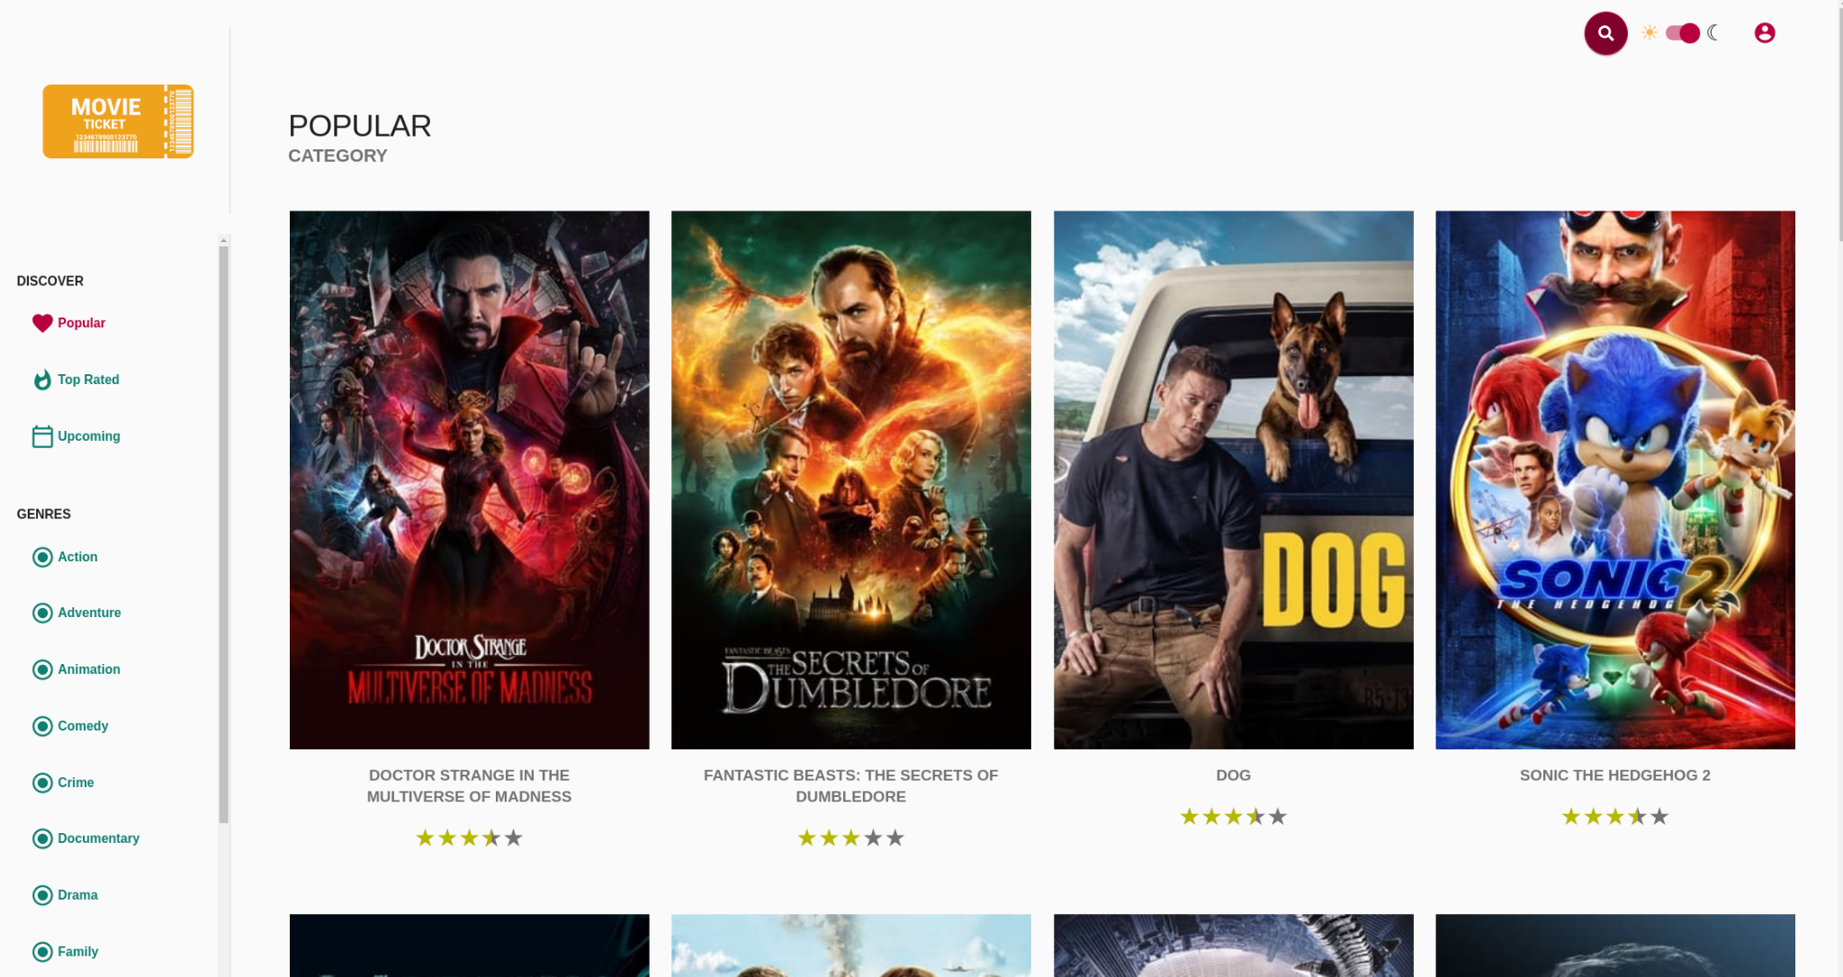

Slide 40
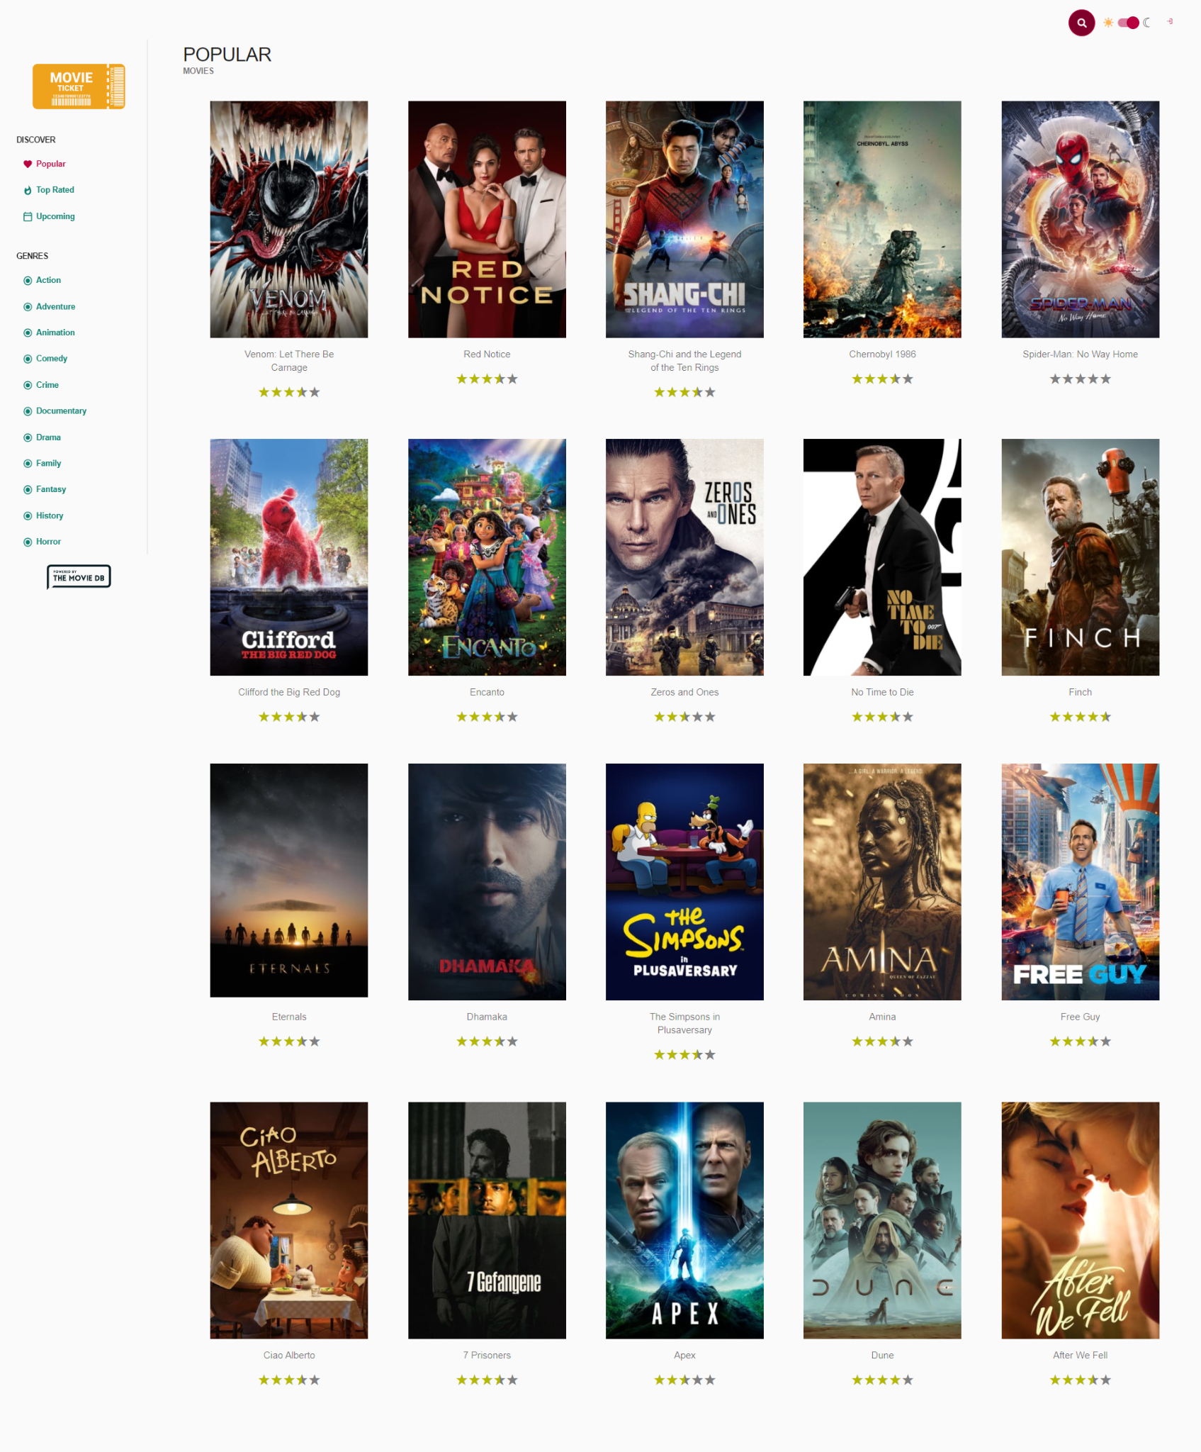
Default
Prioritisation
1
2
2
1

Slide 41
Demo & Exercise Time! Prioritize Work with Strategies

Slide 42
Demo: https://stackblitz.com/edit/angular-ivy-1vfpoe

